Slide 1

Neural Ocean
Project Guide
Prof. Ganesh Gourshete
Madhu Gage | 20104037
Rohan Ahire | 20104133
Darpan Mhatre | 20104019

Slide 2
Contents
Introduction
Objectives
Scope
Literature Survey
Proposed System
Algorithm used
Project Outcomes
Block Diagram
Use Case/DFD
Technology Stack

Slide 3
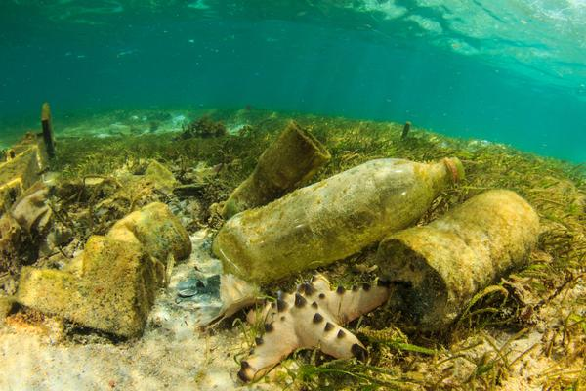
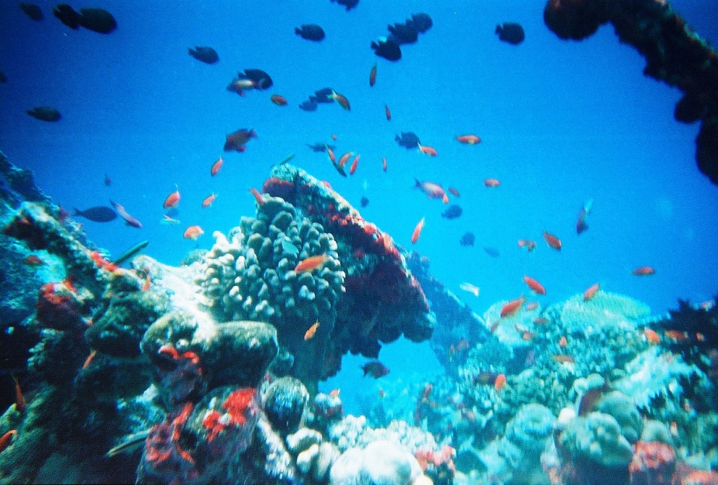
1. Introduction
    Plastic and trash shouldn't be directly thrown into the oceans because it endangers both people and other water-based life.
    An initiative taken to stop ocean pollution, protect water resources, and preserve aquatic life.

Slide 4
Introduction…
    Problem Identified :
    Ocean Pollution being a serious environmental and health problem, It is harmful to marine life, birds, and other animals that encounter it or consume it.
Solution Proposed :
    The proposed solution will be able to identify hazardous waste materials floating in water bodies, allowing for targeted action to be taken to reduce pollution and protect marine life.

Slide 5
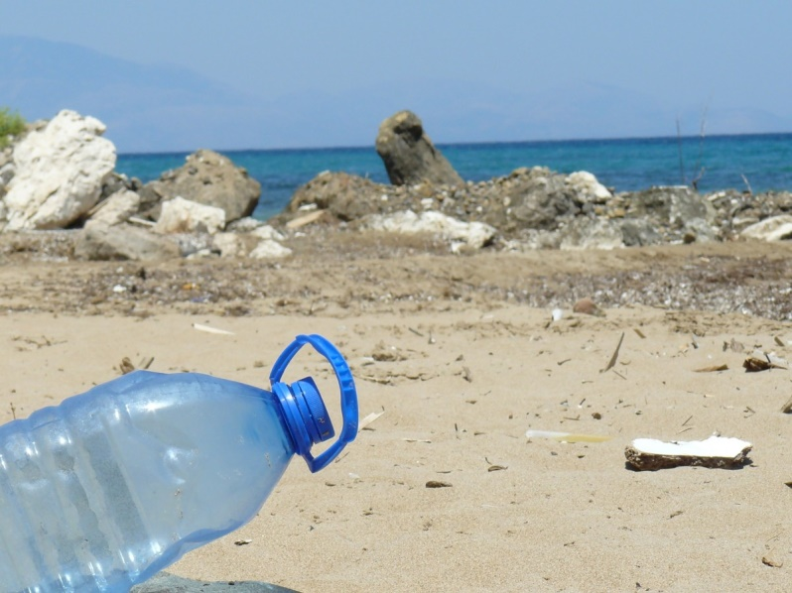
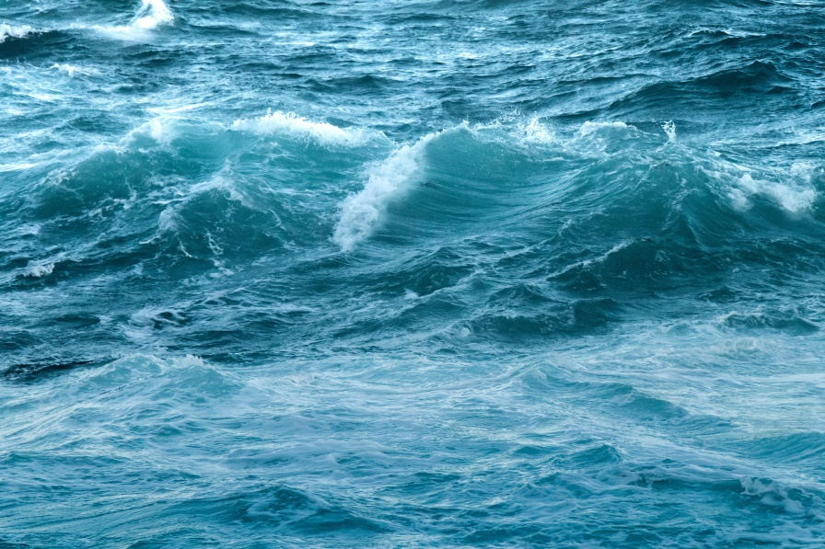
2. Objectives
The objective of the Neural Ocean project is
To spread awareness about ocean pollution.
To identify waste and plastic material present in ocean.
To help organisation to get data about the pollution.

Slide 6
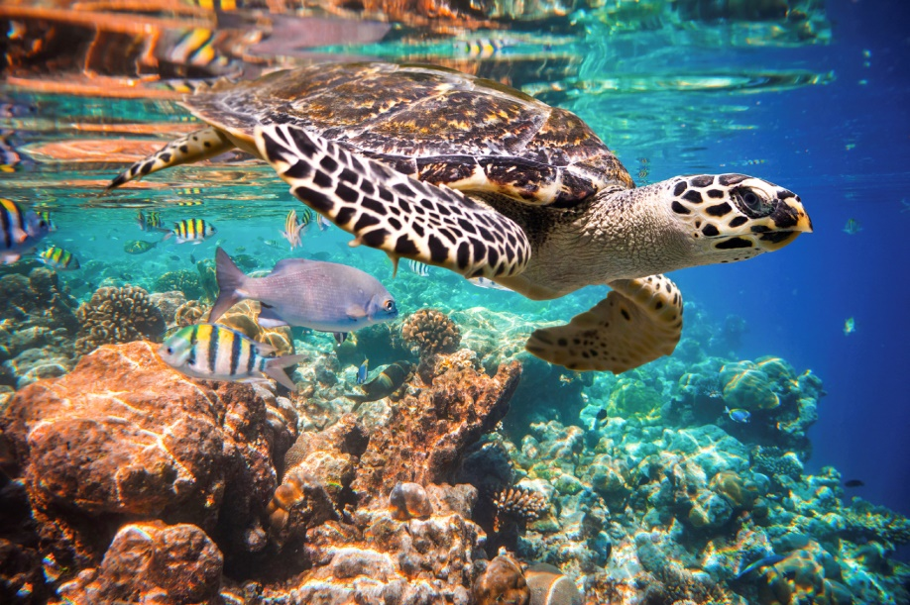
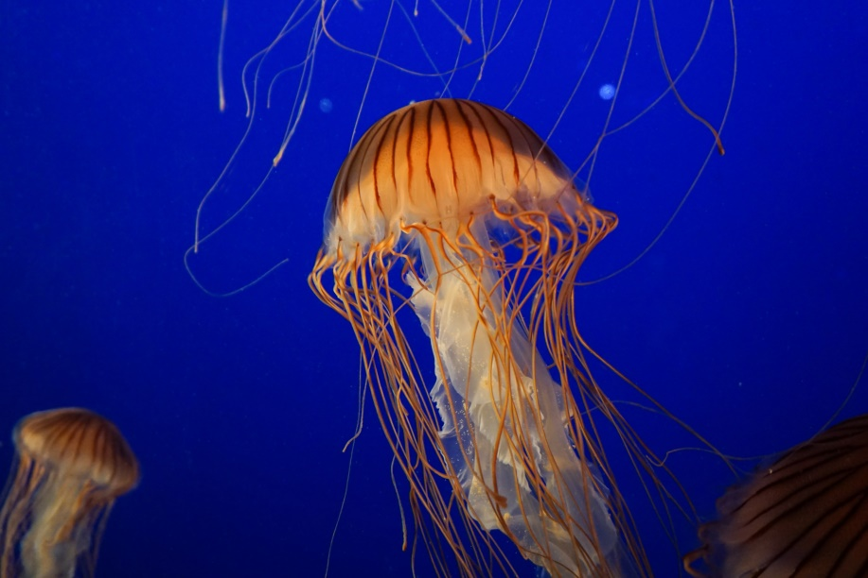
3. Scope
Collection and removal of plastic waste.
Detection and monitoring of pollutants.
Research and development for ocean management.
Educate the public about the importance of protecting the oceans.

Slide 7
4. Literature Survey
Author | Title | Year | Outcome
Geospacial World | Water Quality Mapping with GPS in Indian States | 2016 | GPS integration helped in understanding the location-based details of water contamination. Water Quality Management helped to check the water quality over various states.
Prof. Dr. Bogusław Cyganek | Image Semantic Segmentation of Underwater Garbage | 2022 | Proposed a modified U-Net network structure to match the multiclass target segmentation task of underwater garbage images. They used cameras of the underwater collection robot to construct the underwater garbage dataset and modified the architecture to receive input images and output.
The ocean cleanup | The ocean Cleanup | 2013 | Better understanding the dynamics and quantities flowing into ocean and remote sensing An organisation that cleans and with the help of AI detects the waste present in ocean.

Slide 8
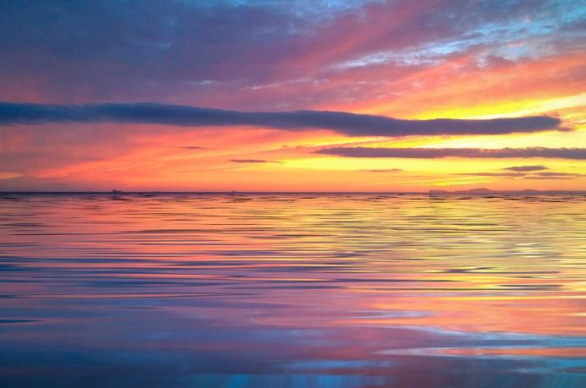
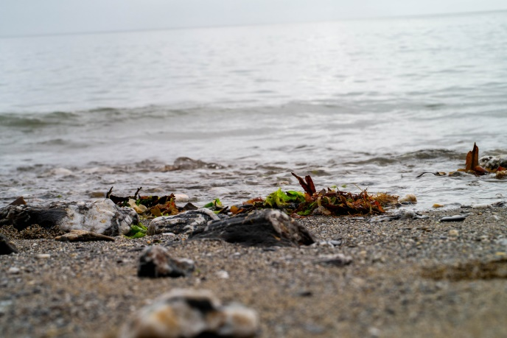
5. Proposed System
Donation option provides financial help to organizations from common people.
Organizations can get data about the waste found in ocean.
Interested person can apply for desired designation.

Slide 9
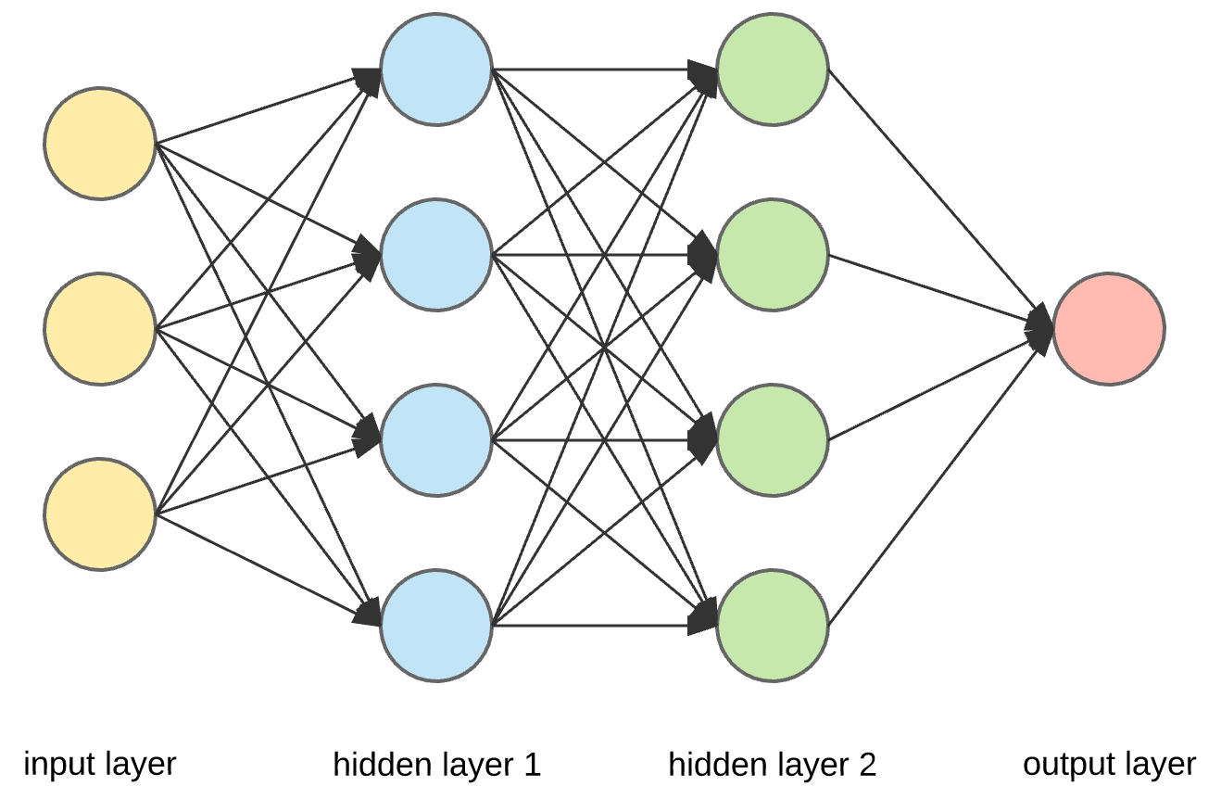
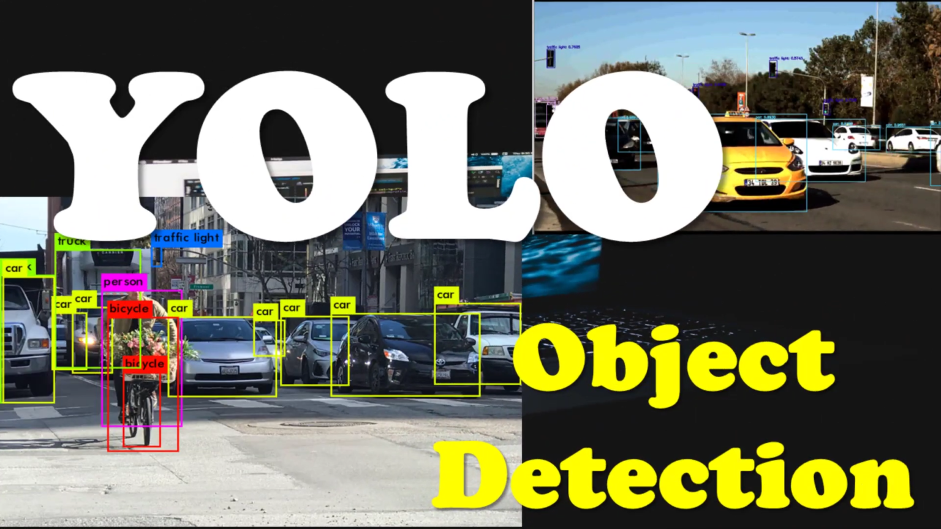
6. Algorithm Used
Convolution Neural Network(CNN)
YOLO v5

Slide 10


7. Outcome of Project
User can donate for the organisations
If user belongs to some organisation he/she can get the data of different regions and rate of pollution in that region.
Anyone keen in a role may apply.

Slide 11
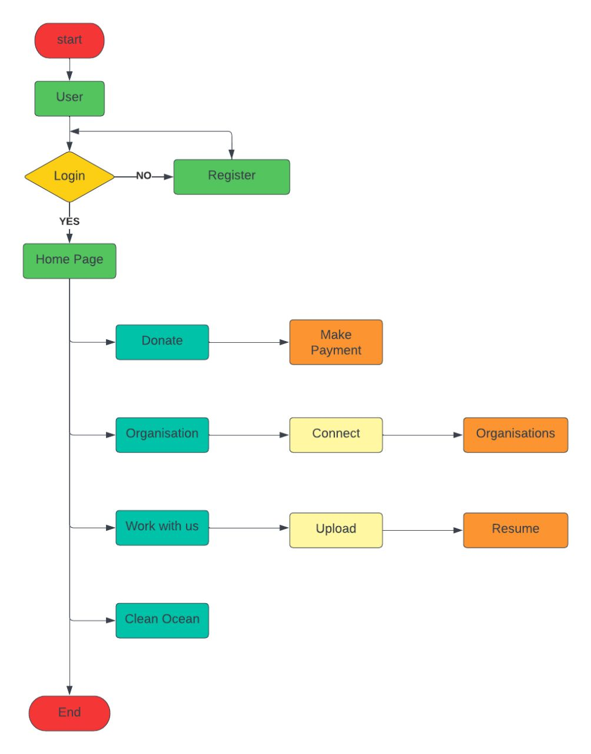
8. Block Diagram

Slide 12
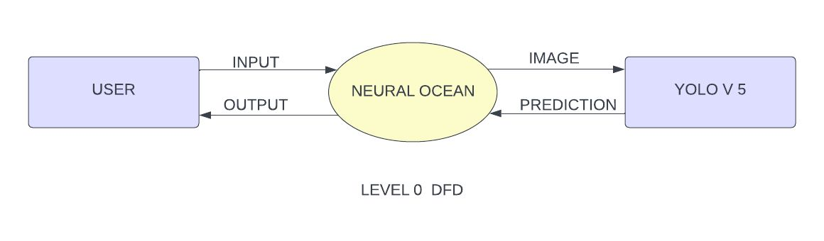
9. Data Flow Diagram
Figure 9.1 DFD Level 0

Slide 13
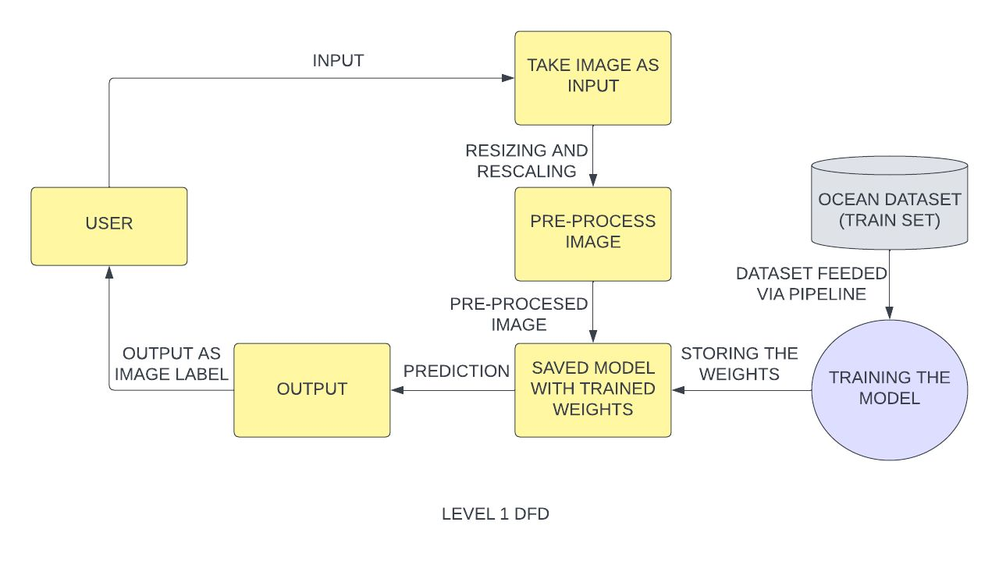
Data Flow Diagram
Figure 9.2 DFD level 1

Slide 14




10. Technology Stack
Frontend/Language: HTML, CSS
Additional Tool: Bootstrap
Operating System: Windows
IDE: Visual Studio Code

Slide 15
Suggestions in Review-1
Implementation of algorithm
Working of ML

Slide 16
Conclusion
An initiative for reducing water pollution, saving water resources and save aquatic life.
Details about the location where the trash if found is pasted on the website.
The data can be accessed by the organisations for cleaning of the locality.
People who are willing to help can join these organisations.
Donate option is available for people willing to provide financial help.

Slide 17
Thank You...!!

